Slide 1
Chapter 11
Cryptographic Hash Functions
Notes:
This chapter begins with a discussion of the wide variety of applications for
cryptographic hash functions. Next, we look at the security requirements for such
functions. Then we look at the use of cipher block chaining to implement a cryptographic
hash function. The remainder of the chapter is devoted to the most important
and widely used family of cryptographic hash functions, the Secure Hash Algorithm
(SHA) family.

Slide 2
Hash Functions
A hash function H accepts a variable-length block of data M as input and produces a fixed-size hash value
h = H(M)
Principal object is data integrity
Cryptographic hash function
An algorithm for which it is computationally infeasible to find either:
(a) a data object that maps to a pre-specified hash result (the one-way property)
(b) two data objects that map to the same hash result (the collision-free property)
Notes:
A hash function H accepts a variable-length block of data M as input and produces
a fixed-size hash value h = H(M ). A “good” hash function has the property that the
results of applying the function to a large set of inputs will produce outputs that are
evenly distributed and apparently random. In general terms, the principal object of a
hash function is data integrity. A change to any bit or bits in M results, with high probability,
in a change to the hash code.
The kind of hash function needed for security applications is referred to as a
cryptographic hash function . A cryptographic hash function is an algorithm for which
it is computationally infeasible (because no attack is significantly more efficient than
brute force) to find either (a) a data object that maps to a pre-specified hash result
(the one-way property) or (b) two data objects that map to the same hash result (the
collision-free property). Because of these characteristics, hash functions are often used
to determine whether or not data has changed.

Slide 3
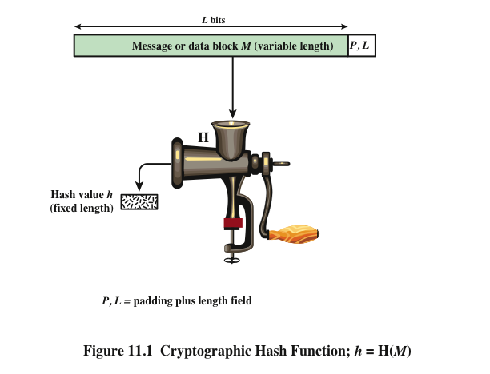
Notes:
Figure 11.1 depicts the general operation of a cryptographic hash function.
Typically, the input is padded out to an integer multiple of some fixed length
(e.g., 1024 bits), and the padding includes the value of the length of the original message
in bits. The length field is a security measure to increase the difficulty for an
attacker to produce an alternative message with the same hash value.

Slide 4
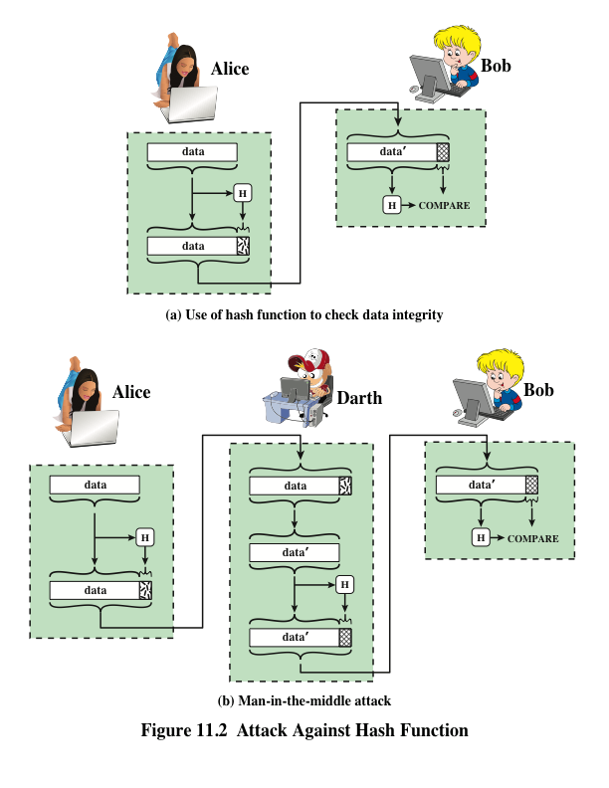
Notes:
Message authentication is a mechanism or service used to verify the integrity of
a message. Message authentication assures that data received are exactly as sent
(i.e., contain no modification, insertion, deletion, or replay). In many cases, there is
a requirement that the authentication mechanism assures that purported identity of
the sender is valid. When a hash function is used to provide message authentication,
the hash function value is often referred to as a message digest .
The essence of the use of a hash function for message authentication is as
follows. The sender computes a hash value as a function of the bits in the message
and transmits both the hash value and the message. The receiver performs the same
hash calculation on the message bits and compares this value with the incoming
hash value. If there is a mismatch, the receiver knows that the message (or possibly
the hash value) has been altered (Figure 11.2a).
The hash function must be transmitted in a secure fashion. That is, the hash
function must be protected so that if an adversary alters or replaces the message,
it is not feasible for adversary to also alter the hash value to fool the receiver. This
type of attack is shown in Figure 11.2b. In this example, Alice transmits a data block
and attaches a hash value. Darth intercepts the message, alters or replaces the data
block, and calculates and attaches a new hash value. Bob receives the altered data
with the new hash value and does not detect the change. To prevent this attack, the
hash value generated by Alice must be protected.

Slide 5
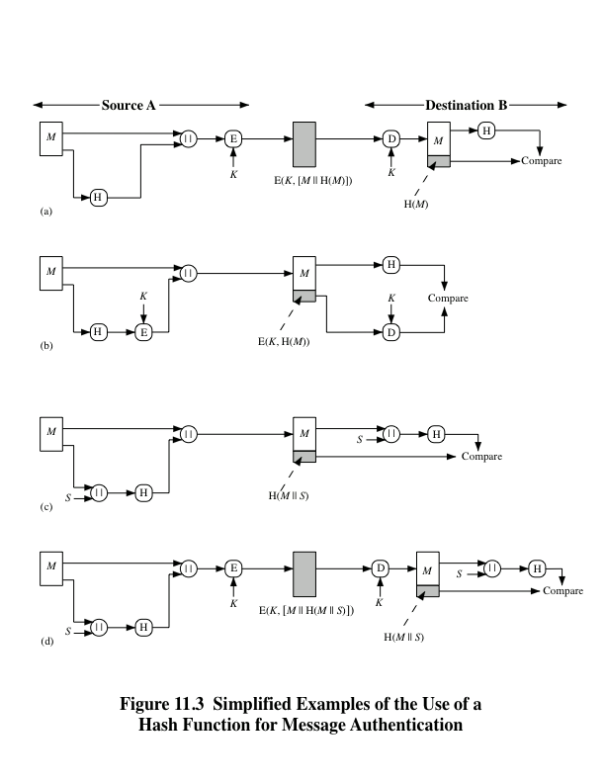
Notes:
Figure 11.3 illustrates a variety of ways in which a hash code can be used to
provide message authentication, as follows:
a. The message plus concatenated hash code is encrypted using symmetric
encryption. Because only A and B share the secret key, the message must
have come from A and has not been altered. The hash code provides the structure
or redundancy required to achieve authentication. Because encryption is
applied to the entire message plus hash code, confidentiality is also provided.
b. Only the hash code is encrypted, using symmetric encryption. This reduces the
processing burden for those applications that do not require confidentiality.
c. It is possible to use a hash function but no encryption for message authentication.
The technique assumes that the two communicating parties share a common secret
value S. A computes the hash value over the concatenation of M and S and
appends the resulting hash value to M. Because B possesses S, it can recompute
the hash value to verify. Because the secret value itself is not sent, an opponent
cannot modify an intercepted message and cannot generate a false message.
d. Confidentiality can be added to the approach of method (c) by encrypting the
entire message plus the hash code.
When confidentiality is not required, method (b) has an advantage over
methods (a) and (d), which encrypts the entire message, in that less computation
is required. Nevertheless, there has been growing interest in techniques that
avoid encryption (Figure 11.3c). Several reasons for this interest are pointed out in
[TSUD92].
• Encryption software is relatively slow. Even though the amount of data to be
encrypted per message is small, there may be a steady stream of messages into
and out of a system.
• Encryption hardware costs are not negligible. Low-cost chip implementations
of DES are available, but the cost adds up if all nodes in a network must have
this capability.
• Encryption hardware is optimized toward large data sizes. For small blocks
of data, a high proportion of the time is spent in initialization/invocation
overhead.
• Encryption algorithms may be covered by patents, and there is a cost associated
with licensing their use.

Slide 6

Message Authentication Code (MAC)
Also known as a keyed hash function
Typically used between two parties that share a secret key to authenticate information exchanged between those parties
Takes as input a secret key and a data block and produces a hash value (MAC) which is associated with the protected message
If the integrity of the message needs to be checked, the MAC function can be applied to the message and the result compared with the associated MAC value
An attacker who alters the message will be unable to alter the associated MAC value without knowledge of the secret key
Notes:
More commonly, message authentication is achieved using a message authentication
code (MAC ), also known as a keyed hash function . Typically, MACs are
used between two parties that share a secret key to authenticate information exchanged
between those parties. A MAC function takes as input a secret key and a
data block and produces a hash value, referred to as the MAC, which is associated
with the protected message. If the integrity of the message needs to be checked, the
MAC function can be applied to the message and the result compared with the associated
MAC value. An attacker who alters the message will be unable to alter the
associated MAC value without knowledge of the secret key. Note that the verifying
party also knows who the sending party is because no one else knows the secret key.
Note that the combination of hashing and encryption results in an overall
function that is, in fact, a MAC (Figure 11.3b). That is, E(K , H(M )) is a function of
a variable-length message M and a secret key K , and it produces a fixed-size output
that is secure against an opponent who does not know the secret key. In practice,
specific MAC algorithms are designed that are generally more efficient than an encryption
algorithm.

Slide 7
Digital Signature
Operation is similar to that of the MAC
The hash value of a message is encrypted with a user’s private key
Anyone who knows the user’s public key can verify the integrity of the message
An attacker who wishes to alter the message would need to know the user’s private key
Implications of digital signatures go beyond just message authentication
Notes:
Another important application, which is similar to the message authentication
Application, is the digital signature . The operation of the digital signature is similar
to that of the MAC. In the case of the digital signature, the hash value of a message
is encrypted with a user’s private key. Anyone who knows the user’s public key
can verify the integrity of the message that is associated with the digital signature.
In this case, an attacker who wishes to alter the message would need to know the
user’s private key. As we shall see in Chapter 14, the implications of digital signatures
go beyond just message authentication.

Slide 8
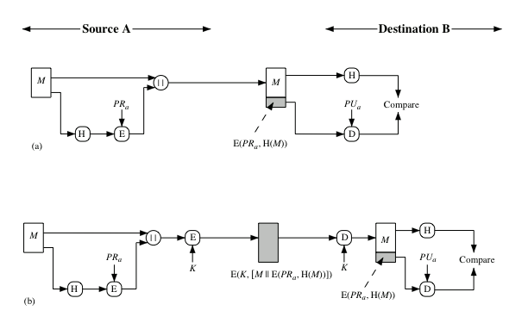

Notes:
Figure 11.4 illustrates, in a simplified fashion, how a hash code is used to provide
a digital signature.
a. The hash code is encrypted, using public-key encryption with the sender’s private
key. As with Figure 11.3b, this provides authentication. It also provides a
digital signature, because only the sender could have produced the encrypted
hash code. In fact, this is the essence of the digital signature technique.
b. If confidentiality as well as a digital signature is desired, then the message
plus the private-key-encrypted hash code can be encrypted using a symmetric
secret key. This is a common technique.

Slide 9
Other Hash Function Uses
Commonly used to create a one-way password file
Can be used for intrusion and virus detection
Can be used to construct a pseudorandom function (PRF) or a pseudorandom number generator (PRNG)
When a user enters a password, the hash of that password is compared to the stored hash value for verification
Store H(F) for each file on a system and secure the hash values
A common application for a hash-based PRF is for the generation of symmetric keys
One can later determine if a file has been modified by recomputing H(F)
This approach to password protection is used by most operating systems
An intruder would need to change F without changing H(F)
Notes:
Hash functions are commonly used to create a one-way password file . Chapter 21
explains a scheme in which a hash of a password is stored by an operating system
rather than the password itself. Thus, the actual password is not retrievable by
a hacker who gains access to the password file. In simple terms, when a user enters
a password, the hash of that password is compared to the stored hash value
for verification. This approach to password protection is used by most operating
systems.
Hash functions can be used for intrusion detection and virus detection . Store
H(F) for each file on a system and secure the hash values (e.g., on a CD-R that is
kept secure). One can later determine if a file has been modified by recomputing
H(F). An intruder would need to change F without changing H(F).
A cryptographic hash function can be used to construct a pseudorandom
function (PRF) or a pseudorandom number generator (PRNG) . A common application
for a hash-based PRF is for the generation of symmetric keys. We discuss this
application in Chapter 12.

Slide 10

Requirements and Security
Preimage
Collision
x is the preimage of h for a hash value h = H(x)
Is a data block whose hash function, using the function H, is h
Because H is a many-to-one mapping, for any given hash value h, there will in general be multiple preimages
Occurs if we have x ≠ y and H(x) = H(y)
Because we are using hash functions for data integrity, collisions are clearly undesirable
Notes:
Before proceeding, we need to define two terms. For a hash value h = H(x ), we say
that x is the preimage of h . That is, x is a data block whose hash function, using the
function H, is h . Because H is a many-to-one mapping, for any given hash value h ,
there will in general be multiple preimages. A collision occurs if we have x ≠ y and
H(x ) = H(y ). Because we are using hash functions for data integrity, collisions are
clearly undesirable.

Slide 11
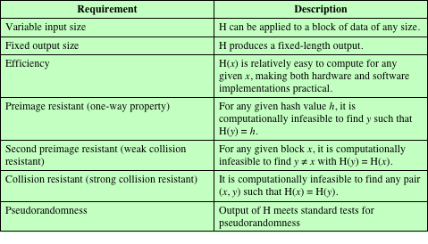
Table 11.1 Requirements for a Cryptographic Hash Function H
(Table can be found on page 323 in textbook.)
Notes:
Table 11.1 lists the generally accepted requirements for a cryptographic hash function.
The first three properties are requirements for the practical application of a
hash function.
The fourth property, preimage resistant , is the one-way property: it is easy
to generate a code given a message, but virtually impossible to generate a message
given a code. This property is important if the authentication technique involves the
use of a secret value (Figure 11.3c). The secret value itself is not sent.
The fifth property, second preimage resistant , guarantees that it is impossible
to find an alternative message with the same hash value as a given message. This
prevents forgery when an encrypted hash code is used (Figures 11.3b and 11.4a). If
this property were not true, an attacker would be capable of the following sequence:
First, observe or intercept a message plus its encrypted hash code; second, generate
an unencrypted hash code from the message; third, generate an alternate message
with the same hash code.
A hash function that satisfies the first five properties in Table 11.1 is referred
to as a weak hash function. If the sixth property, collision resistant , is also satisfied,
then it is referred to as a strong hash function. A strong hash function protects
against an attack in which one party generates a message for another party to sign.
For example, suppose Bob writes an IOU message, sends it to Alice, and she signs
it. Bob finds two messages with the same hash, one of which requires Alice to pay a
small amount and one that requires a large payment. Alice signs the first message,
and Bob is then able to claim that the second message is authentic
The final requirement in Table 11.1, pseudorandomness , has not traditionally
been listed as a requirement of cryptographic hash functions but is more or less implied.
[JOHN05] points out that cryptographic hash functions are commonly used
for key derivation and pseudorandom number generation, and that in message integrity
applications, the three resistant properties depend on the output of the hash
function appearing to be random. Thus, it makes sense to verify that in fact a given
hash function produces pseudorandom output..

Slide 12
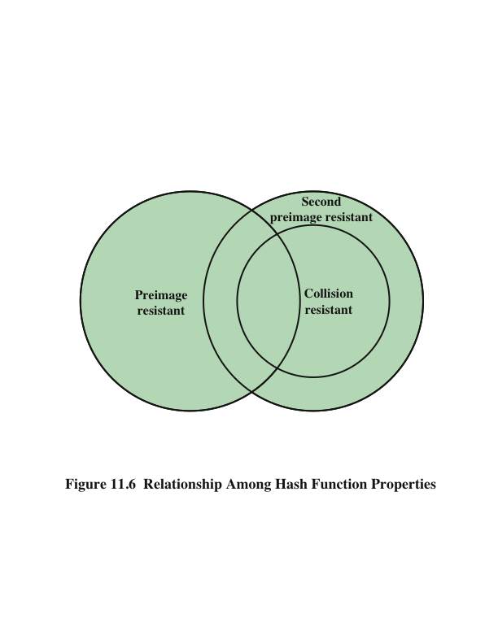
Notes:
Figure 11.6 shows the relationships among the three resistant properties.
A function that is collision resistant is also second preimage resistant, but the
reverse is not necessarily true. A function can be collision resistant but not preimage
resistant and vice versa. A function can be preimage resistant but not second
preimage resistant and vice versa. See [MENE97] for a discussion.

Slide 13
Attacks on Hash Functions
Brute-Force Attacks
Cryptanalysis
Does not depend on the specific algorithm, only depends on bit length
In the case of a hash function, attack depends only on the bit length of the hash value
Method is to pick values at random and try each one until a collision occurs
An attack based on weaknesses in a particular cryptographic algorithm
Seek to exploit some property of the algorithm to perform some attack other than an exhaustive search
Notes:
As with encryption algorithms, there are two categories of attacks on hash
functions: brute-force attacks and cryptanalysis. A brute-force attack does not depend
on the specific algorithm but depends only on bit length. In the case of a hash
function, a brute-force attack depends only on the bit length of the hash value. A
cryptanalysis, in contrast, is an attack based on weaknesses in a particular cryptographic
algorithm.

Slide 14
Secure Hash Algorithm (SHA)
SHA was originally designed by the National Institute of Standards and Technology (NIST) and published as a federal information processing standard (FIPS 180) in 1993
Was revised in 1995 as SHA-1
Based on the hash function MD4 and its design closely models MD4
Produces 160-bit hash values
In 2002 NIST produced a revised version of the standard that defined three new versions of SHA with hash value lengths of 256, 384, and 512
Collectively known as SHA-2
Notes:
In recent years, the most widely used hash function has been the Secure Hash
Algorithm (SHA). Indeed, because virtually every other widely used hash function
had been found to have substantial cryptanalytic weaknesses, SHA was more or
less the last remaining standardized hash algorithm by 2005. SHA was developed
by the National Institute of Standards and Technology (NIST) and published as a
federal information processing standard (FIPS 180) in 1993. When weaknesses were
discovered in SHA, now known as SHA-0, a revised version was issued as FIPS
180-1 in 1995 and is referred to as SHA-1. The actual standards document is entitled
“Secure Hash Standard.” SHA is based on the hash function MD4, and its design
closely models MD4.
SHA-1 produces a hash value of 160 bits. In 2002, NIST produced a revised
version of the standard, FIPS 180-2, that defined three new versions of SHA, with
hash value lengths of 256, 384, and 512 bits, known as SHA-256, SHA-384, and
SHA-512, respectively. Collectively, these hash algorithms are known as SHA-2 .
These new versions have the same underlying structure and use the same types of
modular arithmetic and logical binary operations as SHA-1.

Slide 15
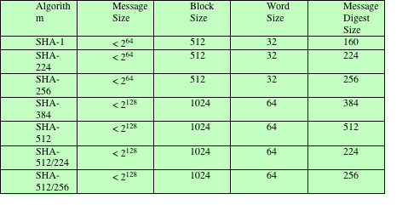
Table 11.3 Comparison of SHA Parameters
Note: All sizes are measured in bits.
Notes:
A revised document was issued as FIP PUB 180-3 in 2008, which added a 224-bit version (Table 11.3).
In 2015, NIST issued FIPS 180-4, which added two additional algorithms:
SHA-512/224 and SHA-512/256. SHA-1 and SHA-2 are also specified in RFC
6234, which essentially duplicates the material in FIPS 180-3 but adds a C code
implementation.
In 2005, NIST announced the intention to phase out approval of SHA-1
and move to a reliance on SHA-2 by 2010. Shortly thereafter, a research team described
an attack in which two separate messages could be found that deliver the
same SHA-1 hash using 2⁶⁹ operations, far fewer than the 2⁸⁰ operations previously
thought needed to find a collision with an SHA-1 hash [WANG05]. This result
should hasten the transition to SHA-2.

Slide 16
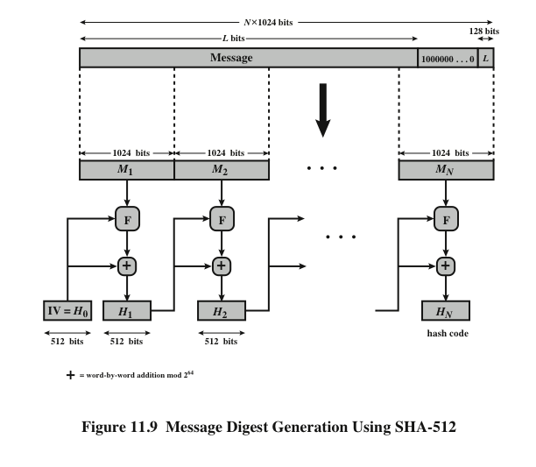
Notes:
The algorithm takes as input a message with a maximum length of less than 2¹²⁸ bits
and produces as output a 512-bit message digest. The input is processed in 1024-bit
blocks. Figure 11.9 depicts the overall processing of a message to produce a digest.
This follows the general structure depicted in Figure 11.8. The processing consists
of the following steps.
Step 1 Append padding bits. The message is padded so that its length is congruent
to 896 modulo 1024 [length = 896(mod 1024)]. Padding is always added,
even if the message is already of the desired length. Thus, the number of
padding bits is in the range of 1 to 1024. The padding consists of a single 1
bit followed by the necessary number of 0 bits.
Step 2 Append length. A block of 128 bits is appended to the message. This block
is treated as an unsigned 128-bit integer (most significant byte first) and
contains the length of the original message (before the padding).
The outcome of the first two steps yields a message that is an integer
multiple of 1024 bits in length. In Figure 11.9, the expanded message is
represented as the sequence of 1024-bit blocks M₁ , M₂ , . . . , M_{N} , so that the
total length of the expanded message is N * 1024 bits.
Step 3 Initialize hash buffer. A 512-bit buffer is used to hold intermediate
and final results of the hash function. The buffer can be represented as eight 64-bit
registers (a, b, c, d, e, f, g, h). These registers are initialized to the following
64-bit integers (hexadecimal values):
a = 6A09E667F3BCC908 e = 510E527FADE682D1
b = BB67AE8584CAA73B f = 9B05688C2B3E6C1F
c = 3C6EF372FE94F82B g = 1F83D9ABFB41BD6B
d = A54FF53A5F1D36F1 h = 5BE0CD19137E2179
These values are stored in big-endian format, which is the most significant
byte of a word in the low-address (leftmost) byte position. These words
were obtained by taking the first sixty-four bits of the fractional parts of the
square roots of the first eight prime numbers.
Step 4 Process message in 1024-bit (128-word) blocks. The heart of the algorithm
is a module that consists of 80 rounds; this module is labeled F in Figure 11.9.
The logic is illustrated in Figure 11.10.
Each round takes as input the 512-bit buffer value, abcdefgh, and
updates the contents of the buffer. At input to the first round, the buffer
has the value of the intermediate hash value, H_{i-1} . Each round t makes
use of a 64-bit value W_{t}, derived from the current 1024-bit block being processed
(M_{i} ). These values are derived using a message schedule described
subsequently. Each round also makes use of an additive constant K_{t} , where
0 ≤ t ≤ 79 indicates one of the 80 rounds. These words represent the first
64 bits of the fractional parts of the cube roots of the first 80 prime numbers.
Step 5 Output. After all N 1024-bit blocks have been processed, the output from
the Nth stage is the 512-bit message digest.

Slide 17
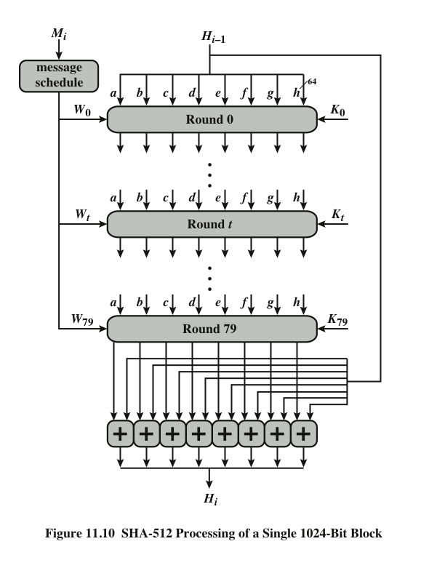
Notes:
The heart of the algorithm is a module that consists of 80 rounds; this module is labeled F in Figure 11.9.
The logic is illustrated in Figure 11.10.

Slide 18
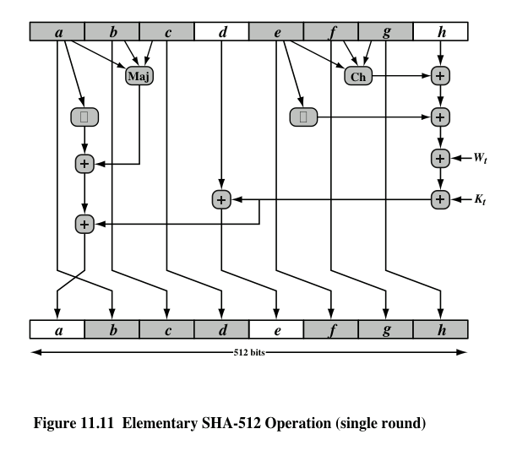
Notes:
Let us look in more detail at the logic in each of the 80 steps of the processing
of one 512-bit block (Figure 11.11).

Slide 19
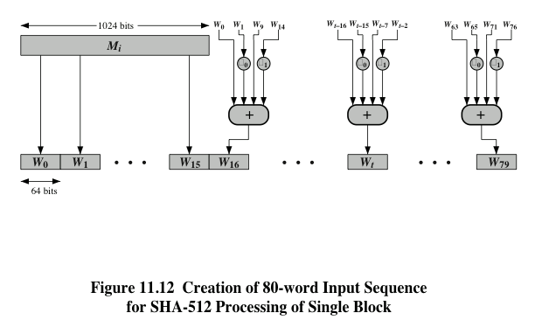
Notes:
Figure 11.12 Creation of 80-word Input Sequence for SHA-512 Processing of Single Block

